Slide 1

COST OF LIVING ANALYSIS

Slide 2
ABSTRACT
This project examines the cost of living in cities and countries worldwide using a dataset with economic indicators such as prices of basic goods, housing, transportation, and entertainment. Using Power BI, we uncover insights into economic disparities between regions and the factors behind varying living costs.
This project serves as an exercise in data visualization, analysis, and interpretation, offering a comprehensive view of the world's economic landscape.

Slide 3
PROBLEM STATEMENT
The cost of living is a critical metric that significantly impacts both individuals and businesses. Understanding the cost of living in different cities and countries is essential for making well-informed decisions regarding relocation, investment, and business expansion. This project aims to address several key questions to provide a comprehensive understanding of the economic landscape across the globe:
What are the cities and countries with the highest and lowest costs of living? •
What are the major cost components contributing to the overall cost of living in a region?
How do factors like average salary, housing costs, and transportation expenses correlate with the cost of living?
Are there any trends or patterns in the data that can help individuals and organizations make strategic decisions?
By addressing these questions, the project seeks to offer valuable insights into the global economic environment, enabling more strategic and informed decision-making for individuals and organizations alike.

Slide 4
DATASET OVERVIEW
Dataset Information:
Exploratory Data Analysis (EDA):
The dataset boasts a wealth of information, spanning 56 columns and covering a wide array of cost-related variables. From the price of a loaf of bread to the cost of a one-bedroom apartment, each data point offers a glimpse into the economic realities of different regions. With data quality assurance in mind, we embark on the journey of exploration.
Before diving into visualizations, we meticulously preprocess and clean the data to ensure accuracy and reliability. Through exploratory data analysis, we uncover trends, outliers, and correlations that pave the way for meaningful insights. From the bustling streets of metropolitan cities to the serene countryside, our analysis leaves no stone unturned.

Slide 5
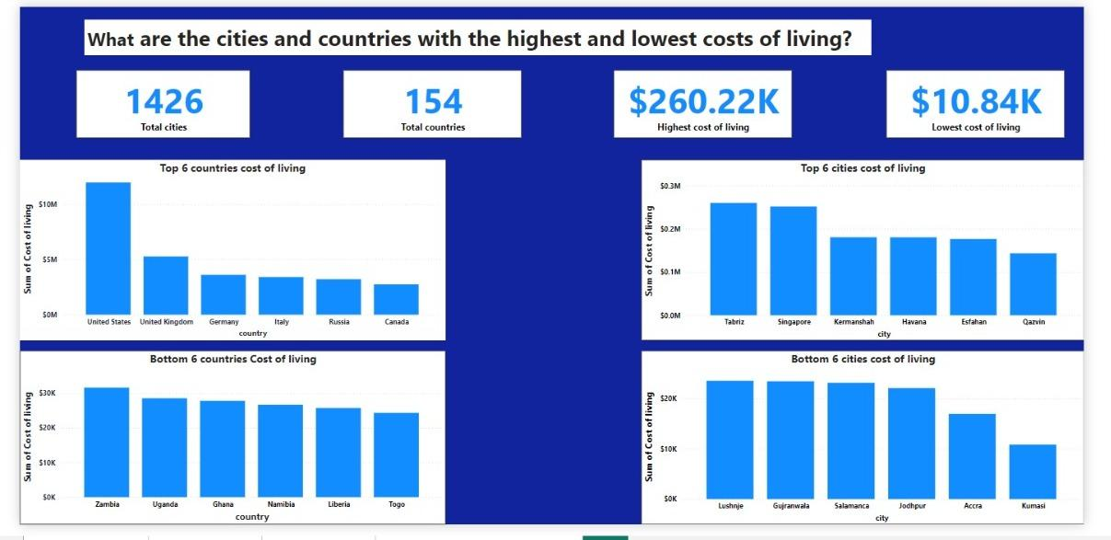

Slide 6
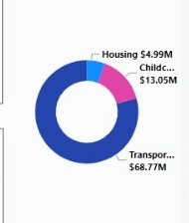
Major cost component contributing to cost of living

Slide 7
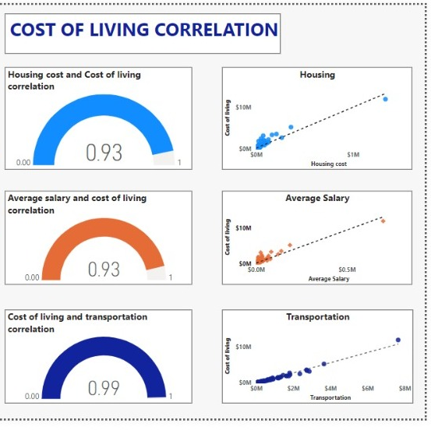
How do factors like average salary, housing costs, and transportation expenses correlate with the cost of living?

Slide 8
Are there any trends or patterns in the data that can help individuals and organizations make strategic decisions?
The analysis highlights significant differences in living costs between countries and cities, driven by factors like housing, transportation, and average salaries. Developed nations and major financial hubs tend to have higher living expenses, while developing countries and smaller cities offer potential savings. Key correlations underscore the importance of housing and transportation costs, with transportation emerging as the dominant expense. Individuals can save by considering relocation and optimizing housing and transportation choices, while businesses can explore cost-saving opportunities in lower-cost areas. Prioritizing data-driven decisions can help both individuals and organizations manage living expenses effectively while aligning with financial and operational goals.

Slide 9
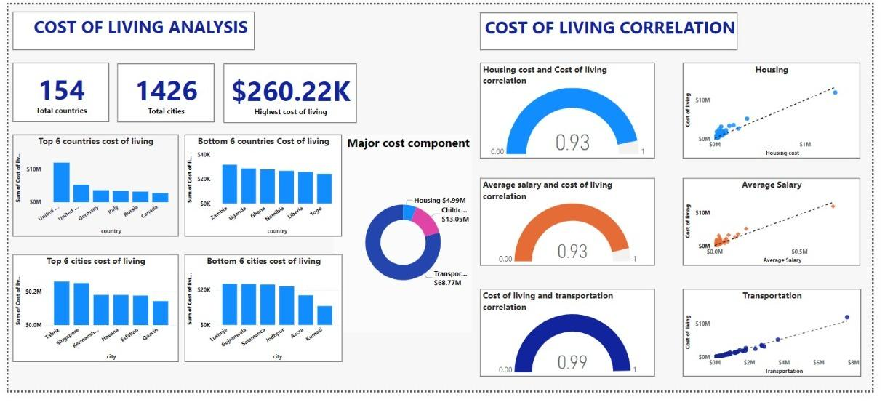

Slide 10
CONLUSION
The analysis of cost of living trends highlights significant disparities between countries and cities, emphasizing the influence of economic development on living expenses. Developed countries such as the United States and Germany, along with major financial hubs like Singapore and New York, exhibit high costs of living driven by expensive housing, transportation, and average salaries. Conversely, developing nations like Zambia and Nigeria, along with cities such as Lahore and Karachi, offer lower living costs, presenting potential savings opportunities for both individuals and businesses.

Slide 11

Thank You
Thank you for your time and attention.

